Slide 1
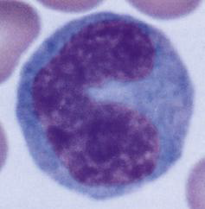
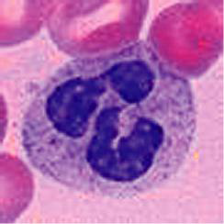
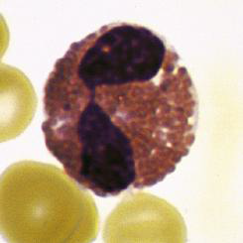
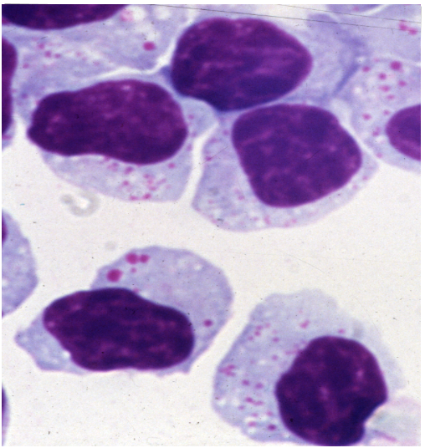
Elements of innate immunity
.
Outline
Compare and contrast the external and internal innate defense systems.
b. Define the functions of : neutrophils, eosinophils, basophils, mast cells, monocytes, macrophages,dendritic cells
c. List the different names for macrophages as they reside in different tissues.
d. Describe phagocytosis and list cells that perform it.
e. Describe receptors involved in the innate immune response
f. Describe NK cells

Slide 2
Innate immunity
present from birth, provide the first line of defense against pathogens. Most m.o encountered daily in the life of a healthy individual are detected and destroyed within min. to hrs by innate defenses

Slide 3
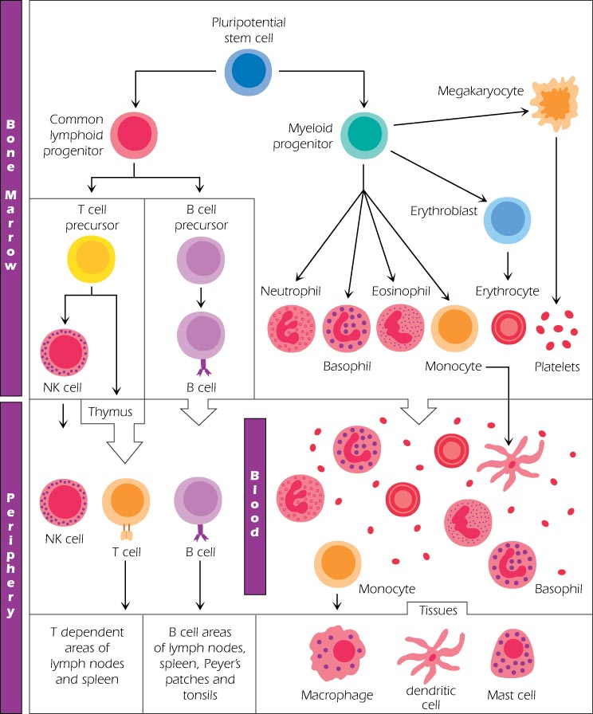
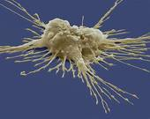
Development pathways of various cell types from pluripotent b.m stem cells.
Stem cell

Slide 4
Physical and chemical barriers
Before entry of m.o skin:
a. physical barrier: most m.o cannot penetrate intact skin. exception: S aureus can enter through sebaceous gland and hair follicles.
b. chemical barrier: acidic pH of sweat (pH of 3 to 5) , sebaceous secretions, fatty acids, hydrolytic enzymes (e.g Lysozyme).
C. Biological barrier: bacteria of which there are around 1000 species upon human skin from 19 phyla. The total number of bacteria on an average human has been estimated at 10^{12.} The normal flora protect us from disease by:
1. Competing with invaders for space and nutrients
2. Producing compounds (bacteriocins) which kill other bacteria
3. Lowering the pH so that other bacteria can't grow

Slide 5
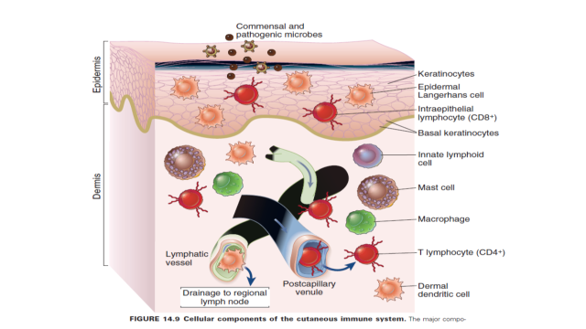

Slide 6
Mucous membrane
  Mucus traps microorganisms that enter the digestive and respiratory systems
Mucus-coated hairs in the nose trap inhaled particles
Mucosa of the upper respiratory tract is ciliated
    Cilia sweep dust- and bacteria-laden mucus away from lower respiratory system. Alcohol, smoking, narcotics suppress this defense system
    Stomach mucosa secrete concentrated HCl and protein-digesting enzymes
    Hydrolytic enzymes in saliva and lacrimal fluid e.g lysozyme
    Low pH of vagina

Slide 7
After entry of m.o into blood
Humoral innate mechanisms:
Interferons (IFN):
are proteins made and released by host cells in response to the presence pathogens such viruses.
IFNs belong to cytokines. IFNs are named after their ability to "interfere" with viral replication within host cells. Uninfected host cells resist new infection by virus.
IFNs activate immune cells, such as natural killer cells and macrophages;
Certain symptoms, such as aching muscles and fever, are related to the production of IFNs during infection.

Slide 8
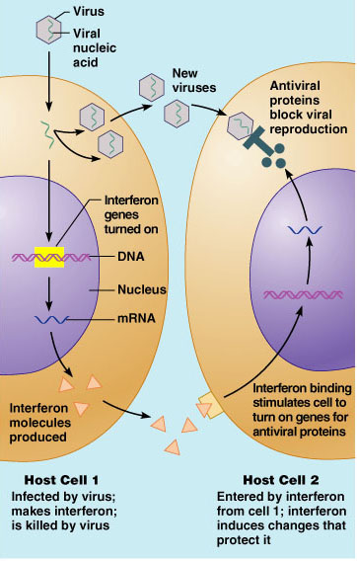

Slide 9
Complement system
The complement system helps or “complements” the ability of antibodies and phagocytic cells to clear pathogens from an organism.
The complement system consists of a number of small proteins found in the blood, generally synthesized by the liver, and normally circulating as inactive precursors (pro-proteins). The end-result of the activation cascade is massive amplification of the response and activation of the cell-killing membrane attack complex.

Slide 10
Antimicrobial Peptides
defensins: are cationic peptides,
.They kill a wide variety of bacteria.
.Neutrophils are rich sources of these peptides,
.Defensins kill microbes rapidly,typically within minutes.
Enzymes such as Lysozymes, are glycoside hydrolases,
  damage bacterial cell walls by catalyzing hydrolysis of peptidoglycan. abundant in a number of secretions, such as tears, saliva, human milk, and mucus.
  present in cytoplasmic granules of the polymorphonuclear neutrophils (PMN).

Slide 11
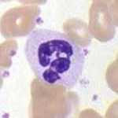
Cells involved in the Innate Immune System (Neutrophils, Macrophages, dendritic cells, NK )
Neutrophils
Neutrophils, eosinophils and basophils, are known as granulocytes due to the presence of granules in their cytoplasm, or as polymorphonuclear cells (PMNs) due to their distinctive lobed nuclei.
A neutrophil count of 2.5–7.5 x 10⁹/L is a standard normal range. The average lifespan of (non-activated human) neutrophils in the circulation is less than 8 hs.
Upon activation, they migrate into tissues,
where they survive less than 24 hs.
In mice, half-lives of 8 to 10 hours.

Slide 12
Neutrophils are the most abundant type of phagocyte, normally representing 50 to 60% of the total circulating leukocytes,
are usually the first cells to arrive at the site of an infection.
The bone marrow of a normal healthy adult produces more than 100 billion neutrophils per day.
Phagocytic cells contain the enzyme-rich lysosomes.
Neutrophil granules contain a variety of toxic substances that kill or inhibit growth of bacteria and fungi (respiratory burst).
The main products of the neutrophil respiratory burst are strong oxidizing agents including hydrogen peroxide, free oxygen radicals and hypochlorite and nitric oxide.

Slide 13
Monocytes and Macrophages
In tissues, organ-specific macrophages are differentiated from phagocytic cells present in the blood called monocytes.
In humans, these monocytes are identifiable by high cell surface expression of CD14, lack of expression of CD16, and expression of the chemokine receptor CCR2.
Functions:
a. phagocytosis of Ags
engulf and destroy the bacteria through the generation of a “respiratory burst”, causing the release of reactive oxygen species.
b. Ag presentation to specific T cells.
C. macrophages produce chemokines, such as TNF-alpha, IL-1, IL-8, and IL-12 to promote an inflammatory response.

Slide 14

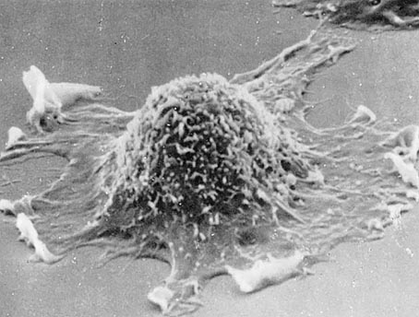
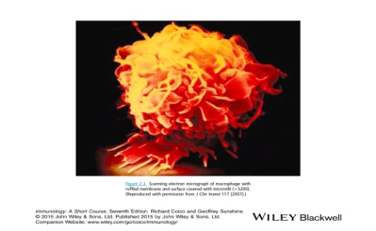
Histological forms of macrophages include the following:
a. Kupfer cells in the liver
b. Alveolar macrophages: in the lung
c. peritoneal macrophages: free floating
d. Microglia cells in the CNS
The network of macrophages population in the body is called Reticuloendothelial system (RES).

Slide 15
The Process of Phagocytosis
Activation of the Phagocyte
Resting phagocytes are activated by inflammatory mediators: bacterial products, complement proteins , inflammatory cytokines , and prostaglandins .
b. Chemotaxis of Phagocytes
Chemotaxis is the movement of phagocytes toward an increasing concentration of some products as LPS.
c. Attachment of the Phagocyte to the Microbe or Cell
is the attachment of microbes to phagocytes by way of an Opsonins that include :-antibody molecule called IgG,
-the complement proteins C3b and C4b, and
-acute phase proteins such as mannose-binding lectin (MBL) and C-reactive protein (CRP).
d. Ingestion of the Microbe or Cell by the Phagocyte
polymerization and then depolymerization of actin filaments

Slide 16
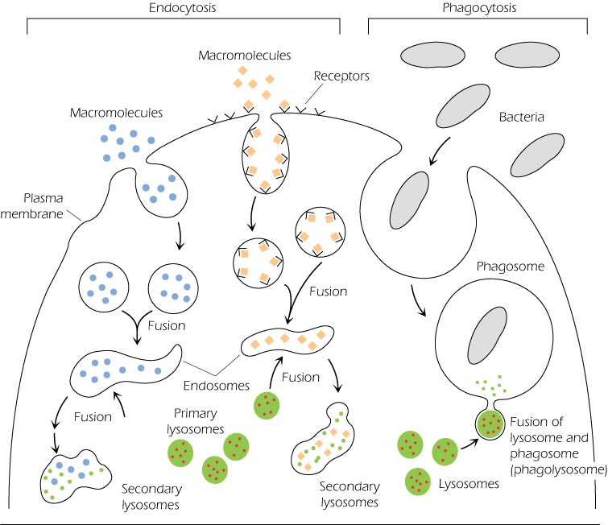
a lysosome fuses with the phagosome: the pH is correct (3.5 - 4.0) for the acid hydrolases to break down cellular proteins

Slide 17
e. Destruction of the Microbe
There are 2 killing systems in neutrophils and macrophages: the oxygen-dependent system and the oxygen-independent system.
1. the oxygen-dependent system: production of reactive oxygen species (ROS) microbicidal because they are powerful oxidizing agents
The enzyme NADPH oxidase converts oxygen into superoxide anion (O²⁻). This can combine with water by way of the enzyme dismutase to form hydrogen peroxide (H₂O₂) and hydroxyl (OH) radicals.
In the case of neutrophils, but not macrophages, the hydrogen peroxide can then combine with chloride (Cl²⁻) ions by the action of the enzyme myeloperoxidase (MPO) to form hypochlorous acid (HOCL), singlet oxygen and nitric oxide (NO) .

Slide 18
2. oxygen-independent system
Some lysosomes contain defensins , cationic peptides that alter cytoplasmic membranes;
lysozyme , an enzyme that breaks down peptidoglycan
lactoferrin , a protein that deprives bacteria of needed iron
cathepsin G , a protease that causes damage to microbial membranes
elastase , a protease that kills many types of bacteria
collagenase ; and various other digestive enzymes that exhibit antimicrobial activity by breaking down proteins, RNA, phosphate compounds, lipids, and carbohydrates.

Slide 19
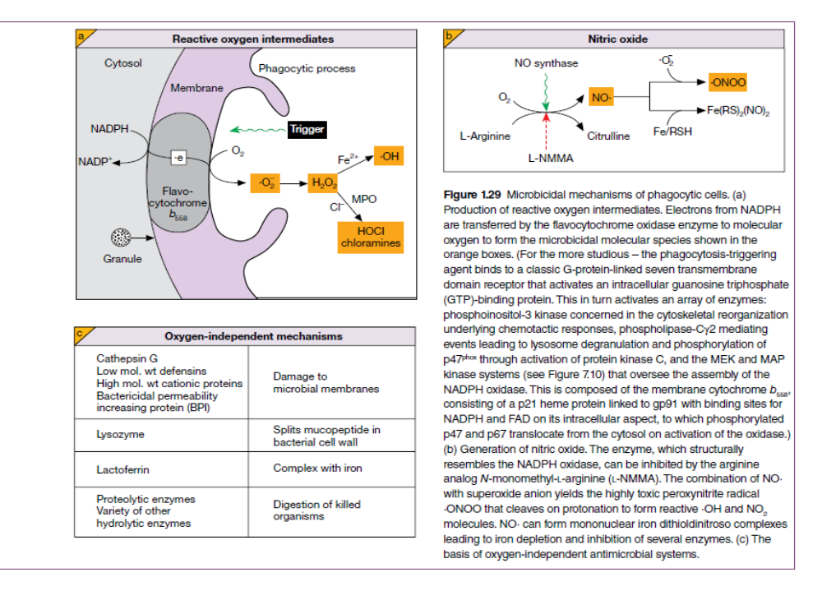

Slide 20
Dendritic cells (DCs)
are immune cells forming part of the mammalian immune system.
a. function as antigen-presenting cells.
b. act as messengers between the innate and adaptive immunity.
2 subsets of DCs have been identified:
plasmacytoid synthesize the IFN α and β in the early phase of i.r. (derived from the common lymphoid progenitor).
Conventional or Myeloid DCs have a major role in the induction of T cell i.r. (derived from the common myeloid progenitor)
Lymphoid and myeloid DCs evolve from lymphoid and myeloid precursors, respectively, and thus are of hematopoietic origin. By contrast, follicular DCs are of mesenchymal origin and do not express MHC class II, but are so named because they are located in lymphoid follicles and have long "dendritic" processes.

Slide 21
DCs are found in tissue that has contact with the outside environment, such as lung mucosa, epithelial cells of the skin (Langerhans cells), and the linings of the nose and the gastrointestinal tract. These regions form the interface between the body and the environment and are constantly exposed to foreign proteins and pathogens.
They can also be found in an immature and mature state in the blood. Once activated, they migrate to the lymph nodes, where they interact with T cells and B cells to initiate and shape the adaptive immune response
DCs that circulate in blood do not have all the typical features of their counterparts in tissue, i.e. they are less mature and have no dendrites
The type and function of the DCs determine whether the initiated immune response is cytotoxic T cells, T-cell tolerance, memory B-cells, or T-helper (Th) cells

Slide 22
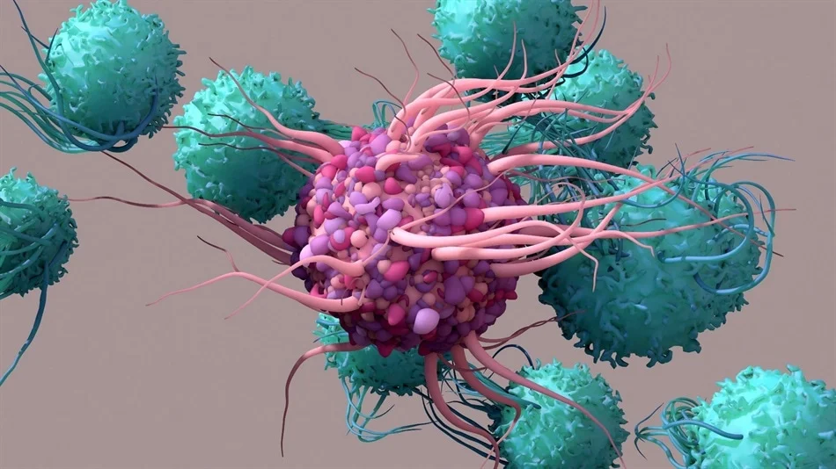
T cells
DC

Slide 23
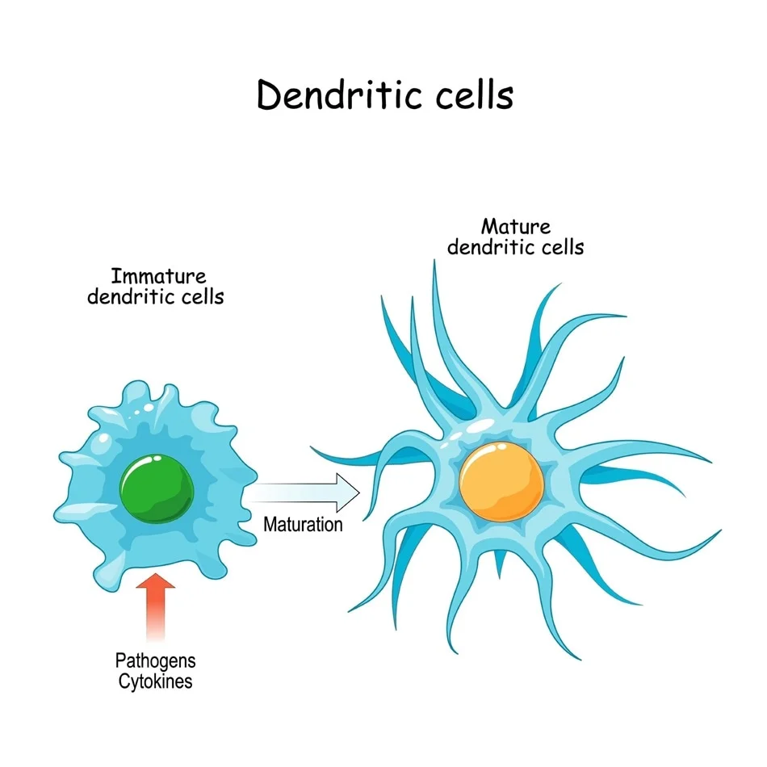

Slide 24
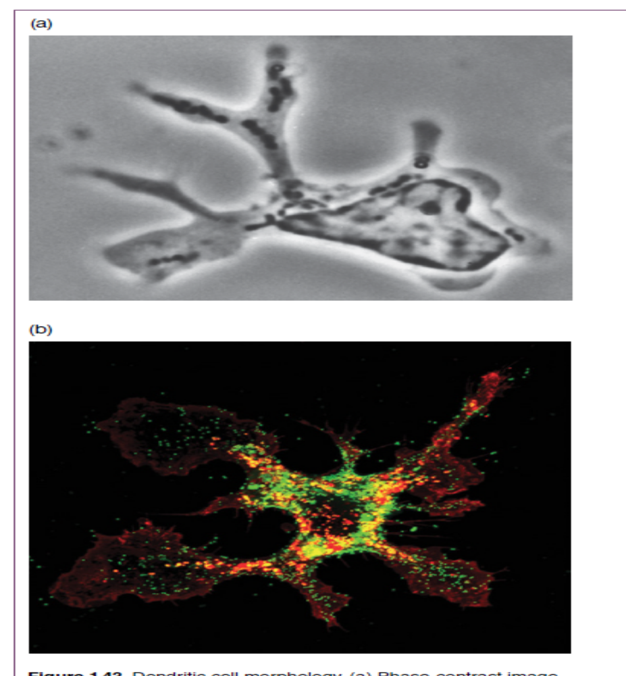
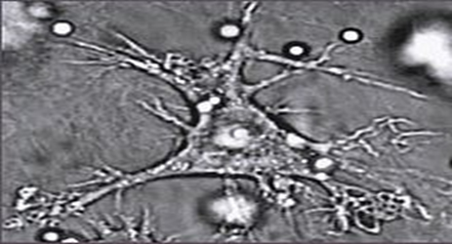

Slide 25
Natural Killer cells
Are large granular lymphocytes, present in an unimmunized individuals
NK cells provide rapid responses to virally infected cells and respond to tumor formation, acting at around 3 days after infection.
NK cells are unique, as they have the ability to recognize stressed cells in the absence of antibodies and MHC, allowing for a much faster immune reaction.
Have intracellular granules that contain preformed biologically potent molecules that are released when NK cell make contact with target cells.
a. These molecules cause the formation of pores in the membrane of target cells leading to its lysis.
b. enter the target cell and cause apoptosis through enhancement of nuclear DNA fragmentation.

Slide 26
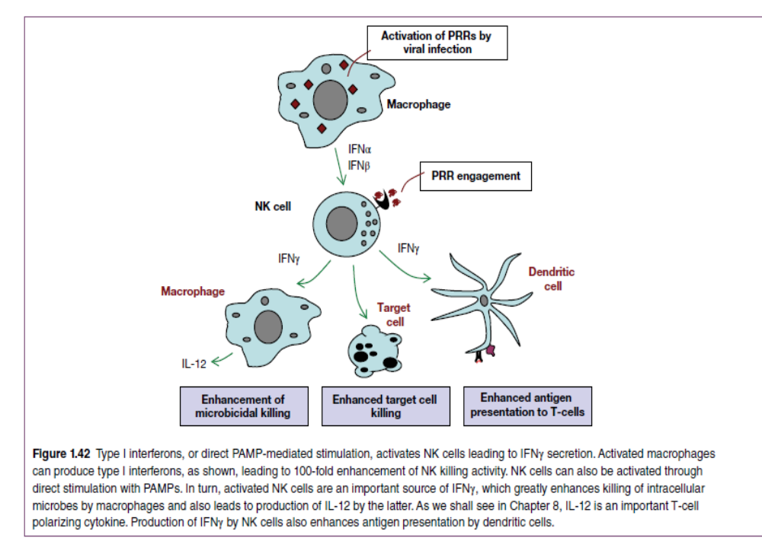

Slide 27
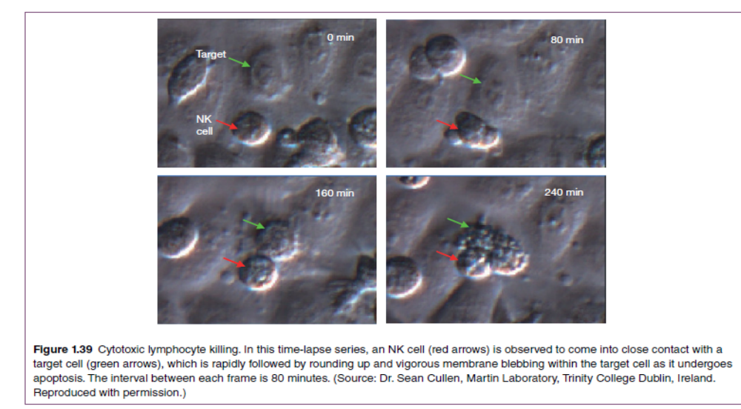

Slide 28
How NK cells discriminate normal from target cell?
MHC class I is expressed on all nucleated cells. NK cells express receptors called Killer cell-inhibitory R (KIR), which bind to MHC class I molecules expressed on normal cells. Upon MHC-KIR binding, intracelluar inhibitory signals are generated which cause inhibition of specific transcription factors. This result in inhibition of NK cells.
Virus-infected cells or tumor cells have significantly reduced numbers of MHC class I molecules on their surfaces. When such cells encounter NK cells, they fail to engage KIRs and become susceptible to cytotoxicity.

Slide 29
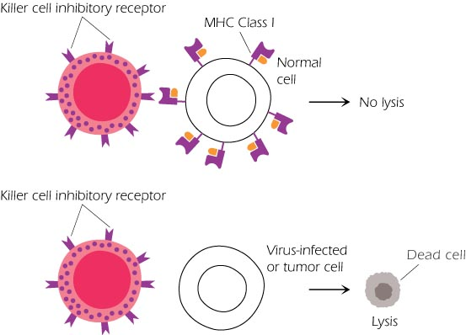
NK cells

Slide 30
Innate lymphoid cells (ILCs)
ILCs are BM–derived cells with lymphocyte morphology that were discovered as cells that produced CKs similar to those made by T cells but lacked TCRs.
We call them “lymphoid cells,” not “lymphocytes,” because they do not express clonally distributed diverse Ag receptors like the T lymphocytes.
ILC do not express PRRs and consequently, they are not directly activated in response to pathogen-associated molecular patterns.
In contrast, they respond to CKs, alarmins and inflammatory mediators derived from myeloid and epithelial cells, and produce immunoregulatory CKs.
ILC do not express markers of T and B lineage (they are CD3- , CD19- ), myeloid cells, or granulocytes, and all express CD132 (γ chain of the IL-2 R), CD127 (IL-7Rα), CD25 (α chain of the IL-2 R),
There are different subsets of ILCs that arise from the same common lymphoid precursor that gives rise to B and T cells

Slide 31
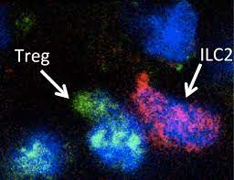

Slide 32
ILCs participate in our immune response to pathogens in all organs, in particular at mucosal surfaces.: They are key in the innate immune response due to their ability to rapidly secrete immunoregulatory CKs.
The feature of ILCs that makes them potentially important for early host defense is that they are always resident in epithelial barrier tissues, poised to react against microbes that breach those barriers.

Slide 33
R involved in the innate immune system
Pattern Recognition R
1)Toll-like receptors (TLRs)
They are large family of receptors, each of which recognizes specific microbial molecular pattern. They play a crucial role in innate cell recognition.
Cell membrane TLR:
TLR1, TLR2 recognize Gram positive bacterial lipoteichoic acid
TLR 4, 5 recognize Gram negative bacterial LPS
TLR7,8 recognizes ssRNA, TLR3 recognizes dsRNA
TLR9 recognize dsDNA
2) Nucleotide-binding oligomerization domain (NOD-like R) or NLR:
.recognize intracellular pathogens (Cytosolic).
.activated by peptidoglycan, RNA, toxins and flagelin.
.Mutation in NLR genes is associated with several autoimmune diseases including cold urticaria, Crohn’s disease and asthma

Slide 34
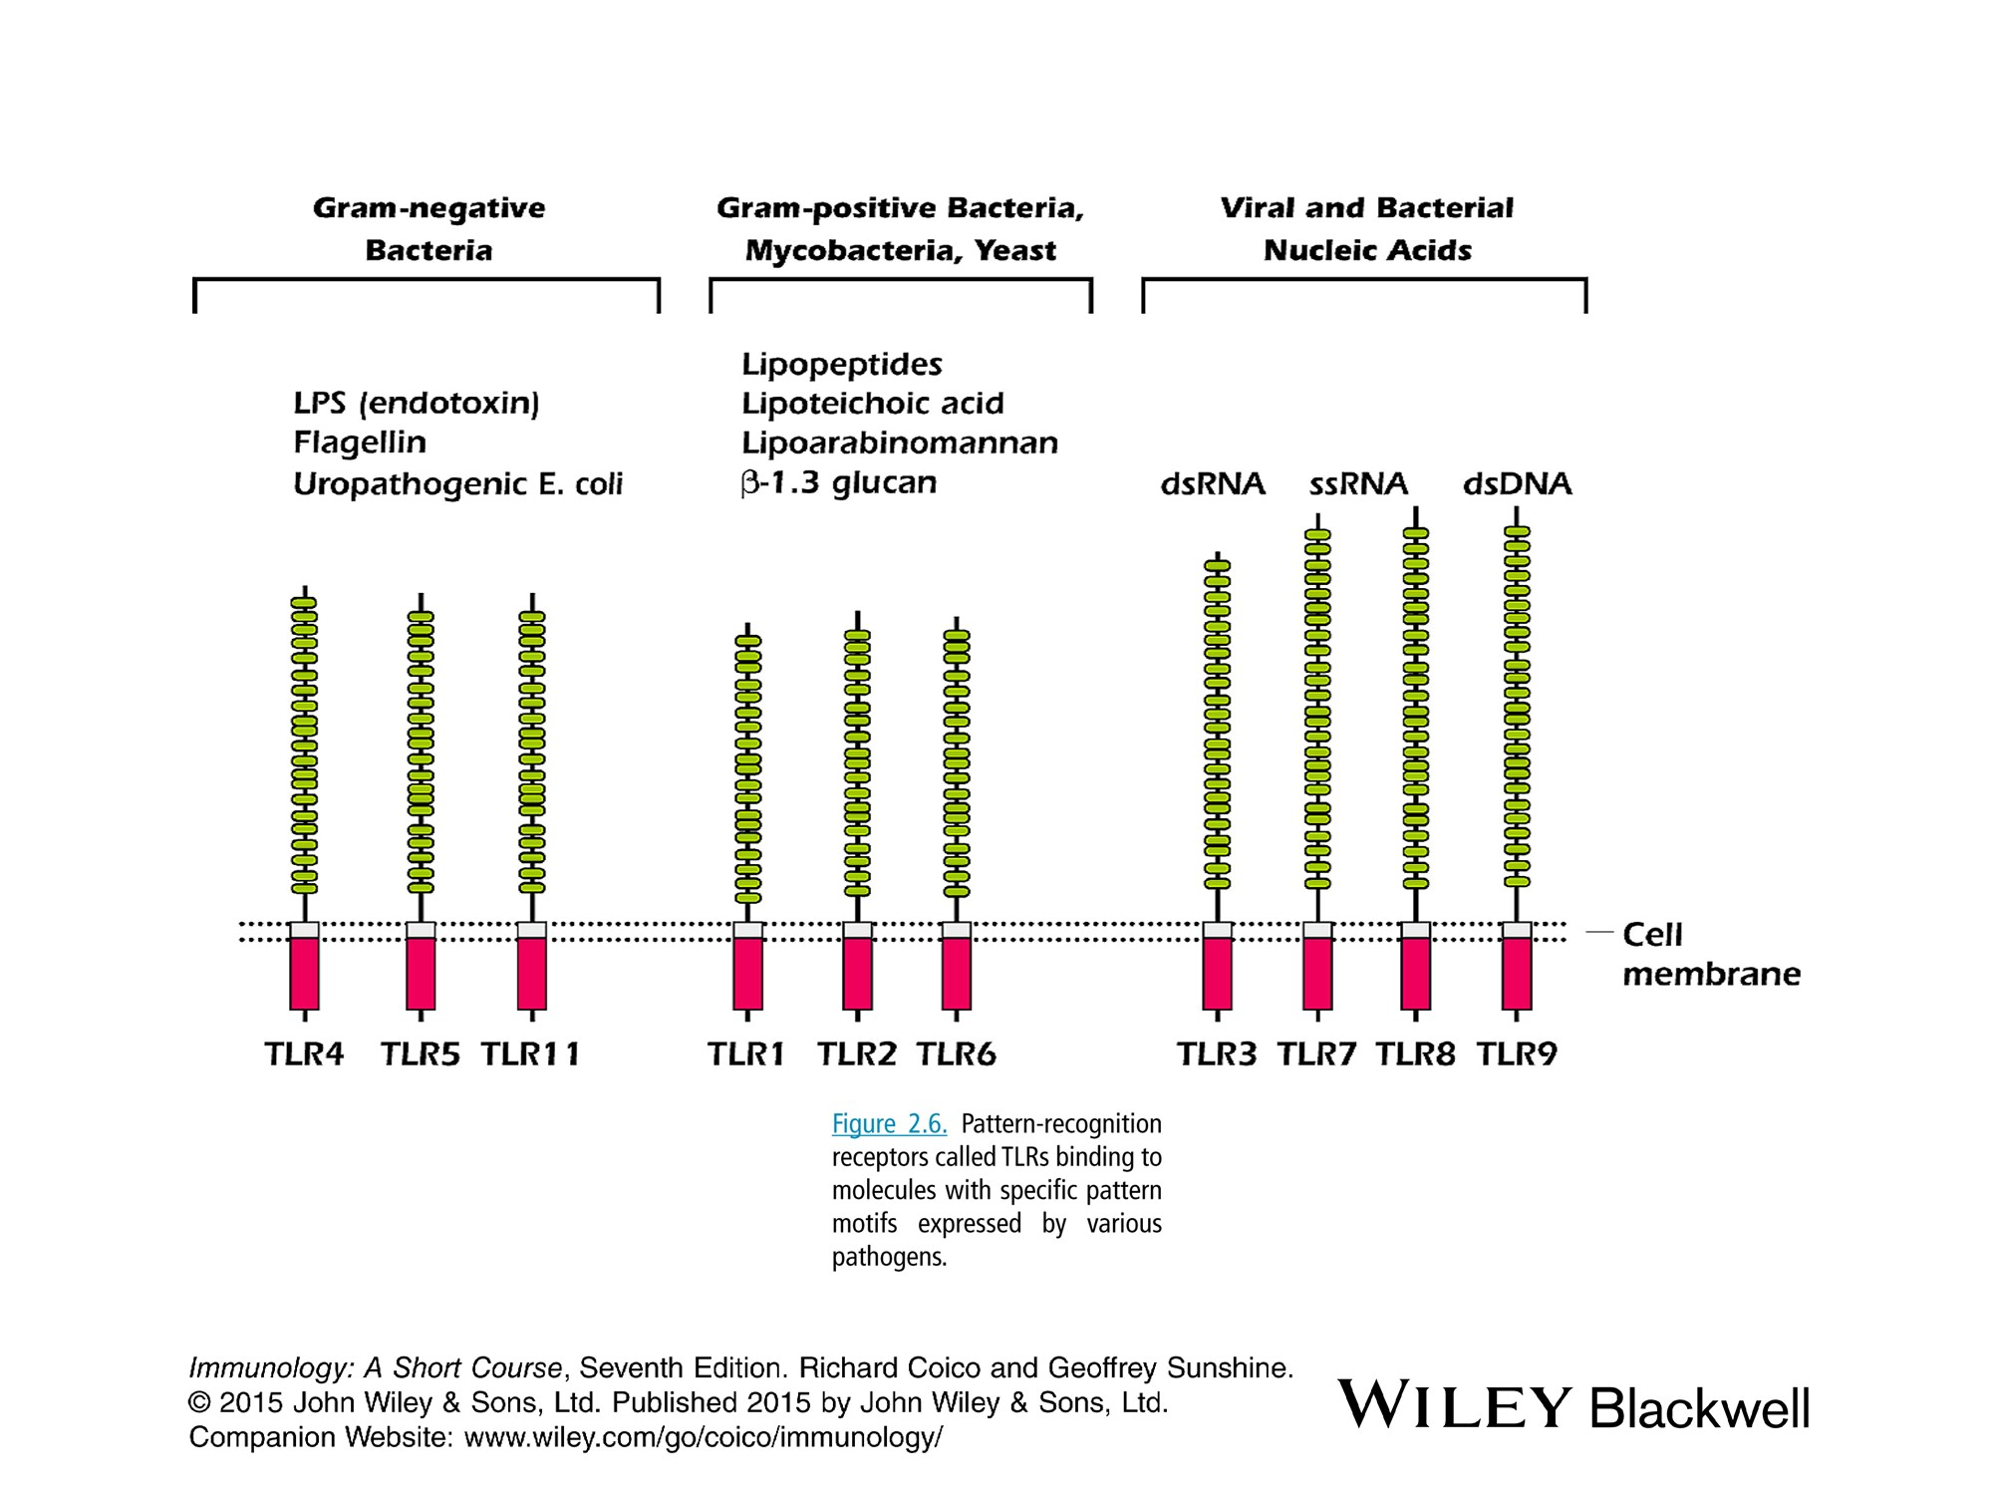


Slide 35
2) Mannan-binding Lectin (MBL)
-allows phagocytes to recognize microbial polysaccharides
-This activates the MB lectin pathway of complement system.
-C3b complement component coat the m.o. causing opsonization.
3) Scavenger R:
.Recognize specific anion polymers and acetylated LDL expressed by certain pathogens.
.recognize dying RBCs leading to their removal. `
.is carried out in the spleen which contains large numbers of macrophages expressing scavenger R.
4) F-Met-Leu-Phe R
Neutrophils express such R that recognizes N-formylated peptides expressed by certain bacteria.
5) RIG-like R
RIG-like receptors (RLRs) are cytosolic sensors of viral RNA that respond to viral dsRNA by inducing the production of the antiviral IFN α and β and inhibit viral replication.

Slide 36
Inflammation
An important function of phagocytic cells is their participation in inflammatory reactions.
A physiological process and a major component of the body’s defense mechanisms is initiated by :
Endogenous factors: such as tissue necrosis or bone fracture
Exogenous factors: include mechanical injury (cut), physical injury (burns), chemical injury ( corrosive chemicals), immunologic injury (hypersensitivity) and biologic injury (infections)

Slide 37
Signs of inflammation: Pain, redness, edema and heat
These can be explained by :
increased vascular permeability that results from the separation of the tightly joined endothelial cells lining the blood vessels. increased blood flow, vasodilation, extravasation of fluids and cellular influx (edema).
Increased expression of adhesion molecules on the endolthelial cells to promote the binding of circulating WBCs to the vessel.
Redness is caused by increased vascular diameter which leads to increase blood flow, thereby causing heat and redness.
Pain due to the swelling and buildup of tissue starts pressing against nerve endings.
The PMN leukocytes accumulate within 30-60 min., if the cause of infl. Response persists, within 4-6 h the area will be infiltrated by macrophages and lymphocytes.

Slide 38
Localized inflammatory response s are generated as a result of the activation of the kinins (potent stimulators responsible for itching and pain) and the coagulation systems (plasma enzymes that are activated in a cascading manner following damage to blood vessels).
Systemic inflammatory responses include the induction of fever, increased in WBC count, increase synthesis of ACTH and cortisone hormones, and acute phase proteins such as C-reactive protein (CRP) that bind to m.o. and activating the complement system.
The cytokines that play a key role in the inflammatory response include IL-1, IL-6, TNF-α.

Slide 39
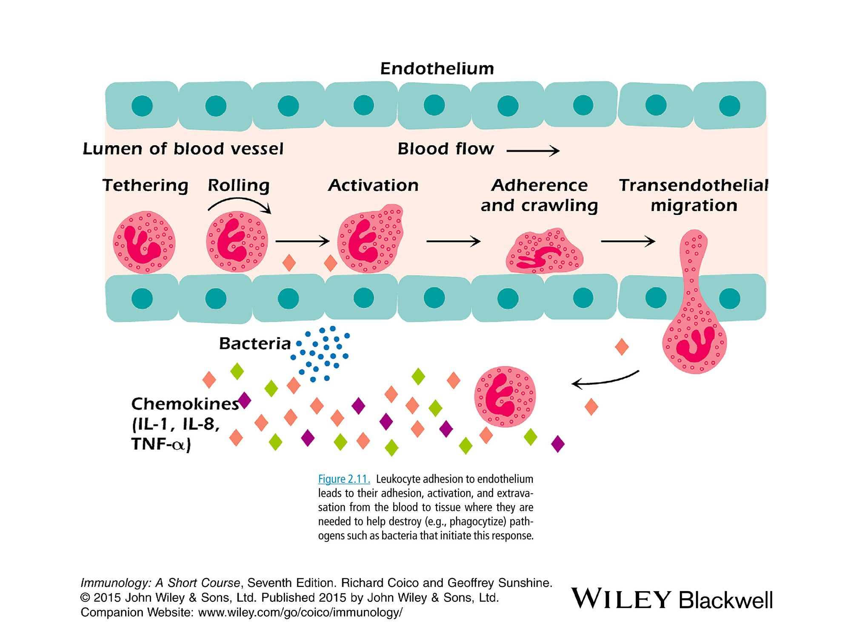

Slide 40
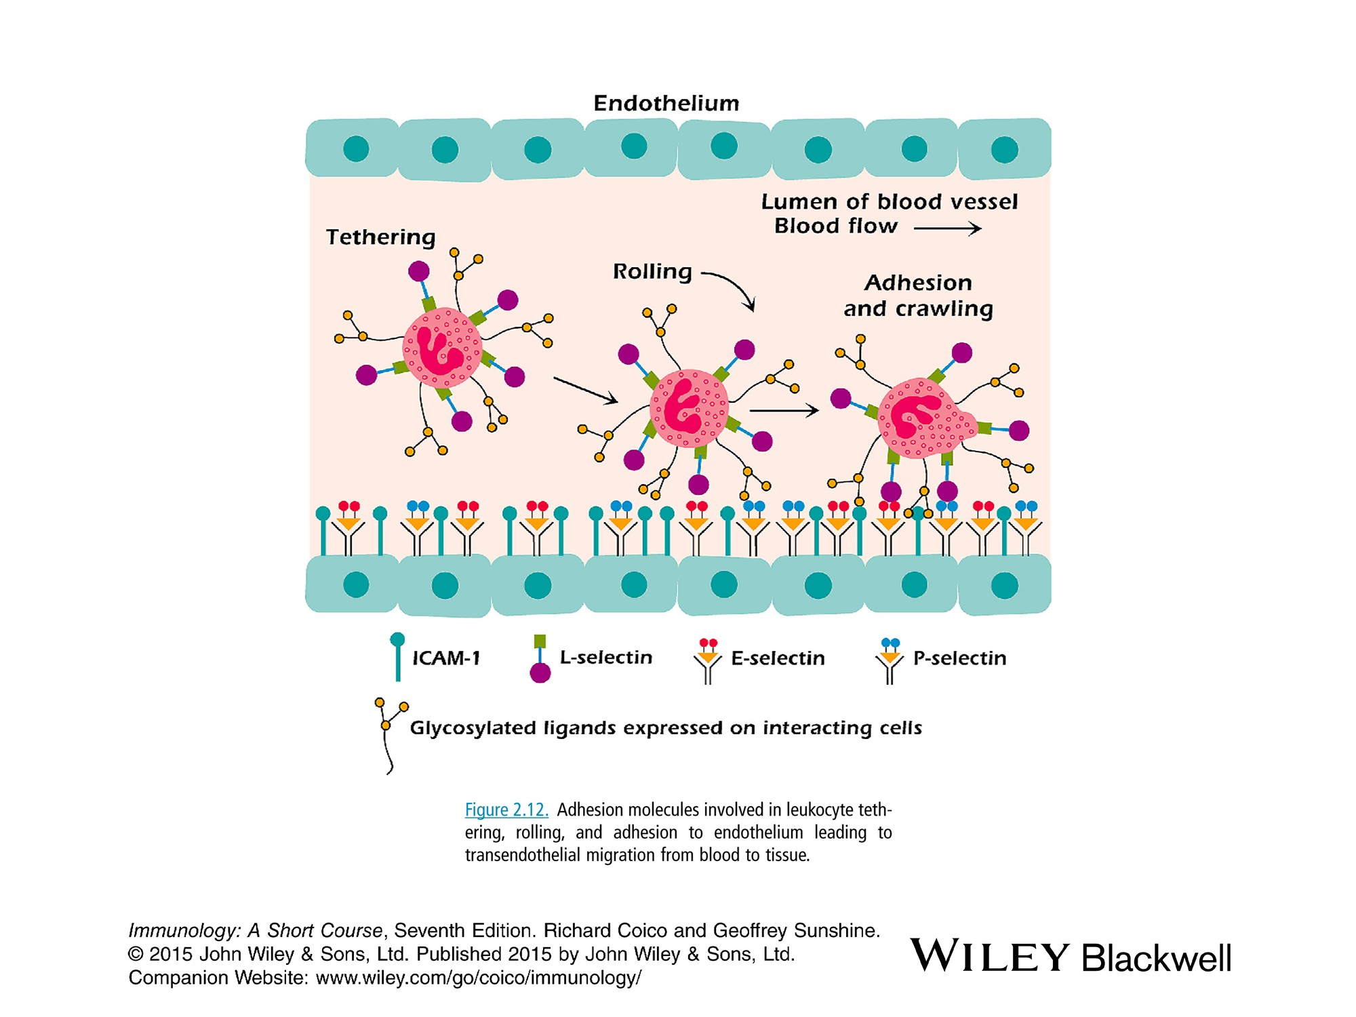

Slide 41
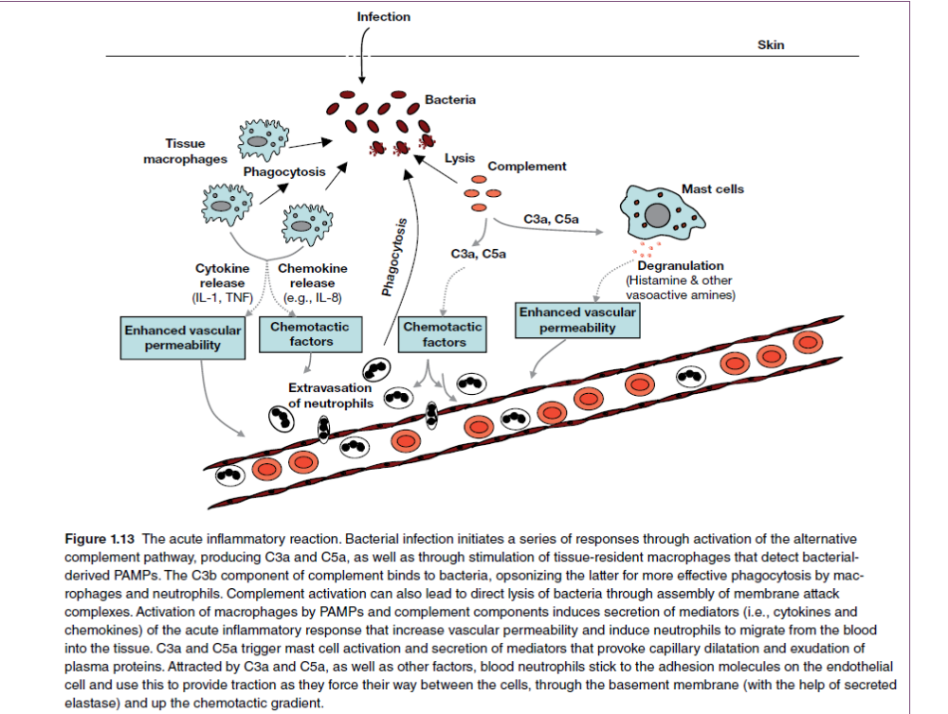

Slide 42
Chronic inflammation:
Sometimes it is difficult to remove the causes of inflammation such as tuberculosis, rheumatiod arthritis and glomerulonephritis), chronic inflammation occurs.
Administration of anti-inflammatory drugs such as aspirin, ibuprofin and cortisone decrease the symptoms but do not affect the root cause of the inflammation, when they are withdrawn, the symptoms may return.
Fever:
is caused by many bacterial products namely the endotoxins of Gram-negative bac.
Endotoxins→ monocytes and mac release endogenous pyrogens cytokines (IL-1, IL-6, TNF- α and IFN) →few hrs fever with accompanying chills and malaise.
When skin is overexposed to the UV light (sunburn), keratinocytes are damaged, causing the release of IL-1.

Slide 43
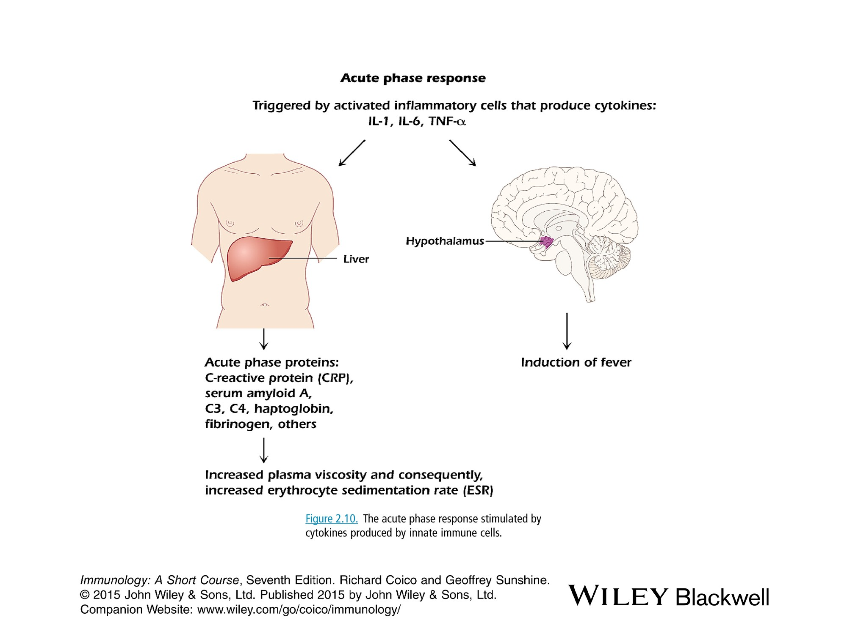

Slide 44
Liver and immunity
The liver is considered a unique immunological organ and a frontline immune organ that is constantly exposed to a variety of gut-derived antigens as a result of its unique location and blood supply
As a lymphoid organ, the liver contains a diverse population of innate lymphocytes, such as NK cells, natural killer T (NKT) cells, and γδ T cells, and adaptive lymphocytes, such as αβT cells and B cells.
In particular, intrahepatic lymphocytes have a unique subset composition, with a notable enrichment in innate immune cells. In humans, up to 65% of all hepatic lymphocytes consist of NK cells, NKT cells, and γδ T cells

Slide 45
NK cell effector functions are controlled by a variety of cell surface activating and inhibitory receptors.
Some activating receptor ligands are inducible in conditions of cellular stress, rendering the stressed cell susceptible to lysis by NK cells.
The MHC class I-specific inhibitory receptors, including the killer cell immunoglobulin-like receptors in humans, the lectin-like Ly49 dimers in mice. In general, healthy cells constitutively express MHC class I, which binds to NK cell inhibitory receptors, allowing the cell to avoid NK cell attack

Slide 46
The liver has been recognized as an immune-tolerant organ, as liver allografts are less likely to be rejected than other transplanted organs.
Moreover, liver allografts lead to donor-specific tolerance that can further facilitate the acceptance of other donor-originated organs, such as heart or kidney allografts, without the need for immunosuppressive agents.
In addition, hepatic tolerance also refers to the fact that the liver is tolerant to a large number of dietary and commensal antigens under homeostatic conditions.

Slide 47
Given their ability to secrete proinflammatory cytokines and mediate cytotoxicity, it is not surprising that NK cells can induce liver immunity toward an immunogenic status.
It has been reported that polyinosinic/polycytidylic acid (poly I:C), which is a synthetic viral RNA mimic, induces NK cell activation and accumulation in the liver, leading to mild hepatitis.
The liver has the unique ability to regenerate after tissue damage, and several lines of evidence have indicated that NK cells play a role in liver regeneration.
Suppressing NK cell activity treatment promotes liver regeneration, whereas the poly I:C- or viral infection-induced activation of NK cells negatively regulates liver regeneration in an IFN-γ-dependent manner.

